Slide 1
Mathematical Foundations for Intelligent Systems
HIDDEN MARKOV MODEL

Slide 2
Outline
Markov Model
Hidden Markov Model
HMM Problems
HMM – Forward Algorithm
HMM- Viterbi Algorithm

Slide 3
Markov Models
A Markov Model is a stochastic model which models data that are ordered. (Eg. Sequential or temporal data)
It models the dependencies of current information with previous information ( For eg: weather , stock market etc., )
A Markov model is a finite state machine with N distinct states begins at (Time t = 1) in initial state .
It moves from current state to Next state according to the transition probabilities associated with the Current state
This kind of system is called Finite or Discrete Markov model.

Slide 4
Markov Property
Markov Property : The Current state of the system depends only on the previous state of the system
The State of the system at Time [ T+1 ] depends on the state of the system at time T.
X_{t=1}
X_{t=2}
X_{t=3}
X_{t=4}
X_{t=5}

Slide 5
Example of Markov Model
0.3
0.7
Rain
Sunny
0.2
0.8
Two states : ‘Rain’ and ‘Sunny’.
Transition probabilities: P(‘Rain’|‘Rain’)=0.3 , P(‘Sunny’|‘Rain’)=0.7 , P(‘Rain’|‘Sunny’)=0.2, P(‘Sunny’|‘Sunny’)=0.8
Initial probabilities: say P(‘Rain’)=0.4 , P(‘Sunny’)=0.6 .

Slide 6
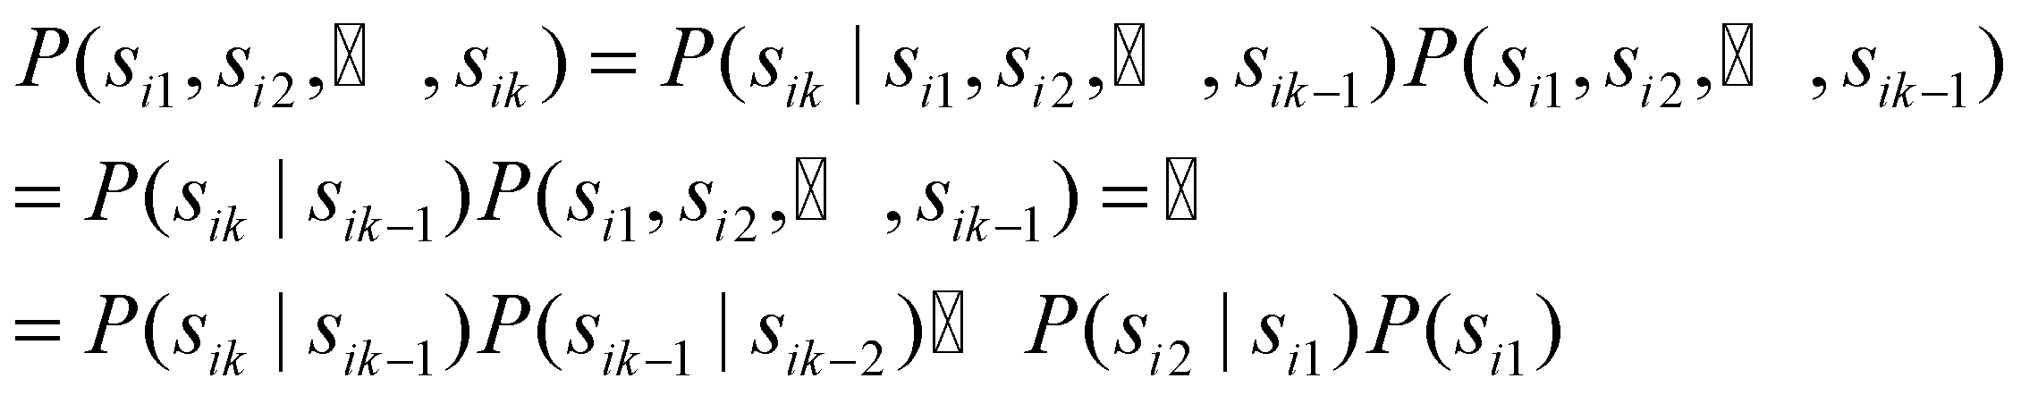
Calculation of sequence probability
By Markov chain property, probability of state sequence can be found by the formula:
Suppose we want to calculate a probability of a sequence of states in our example, {‘Sunny’,’Sunny’,’Rain’,Rain’}.
P({‘Sunny’,’Sunny’,’Rain’,Rain’} ) =
P(‘Sunny’) P(‘Sunny’|’Sunny’) P(‘Rain’|’Sunny’) P(‘Rain’|’Rain’) =
= 0.6 *0.8*0.2*0.3

Slide 7
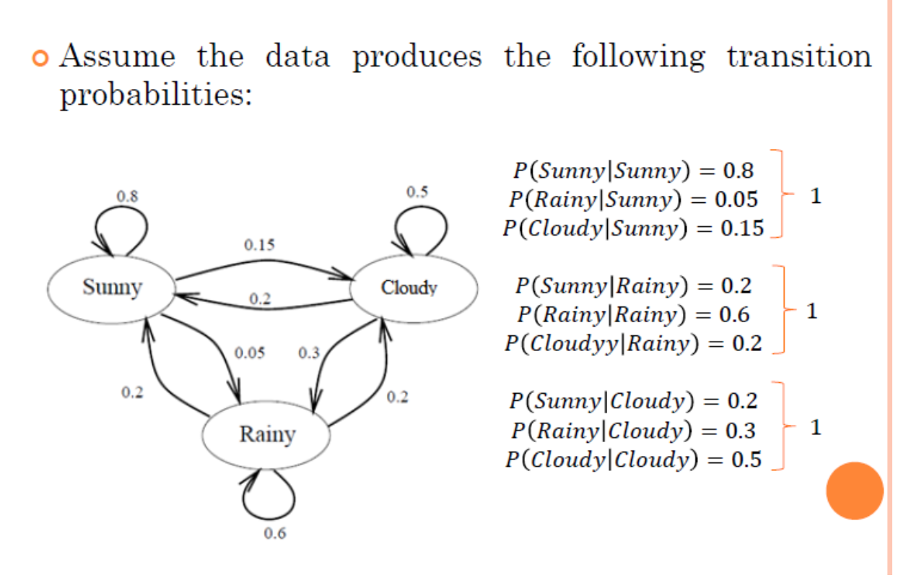
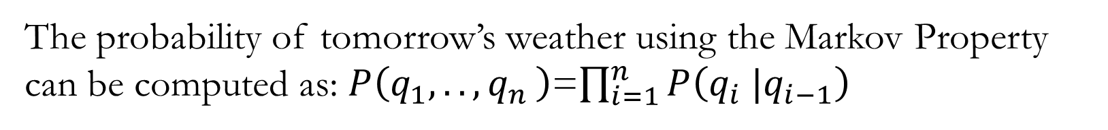
Suppose the sequence : Sunny, Rainy ,Cloudy, Cloudy, Sunny, Sunny, Sunny, Rainy,…
So in a day we can be in any of the three states

Slide 8
Markov Chain : Weather Prediction Example
Design a Markov Chain to predict the weather of tomorrow using previous information of the past days.
The model has only 3 states ,S={S1,S2,S3} , where S1 =Sunny, S2=Rainy and S3=Cloudy
The following are the transition probabilities

Slide 9
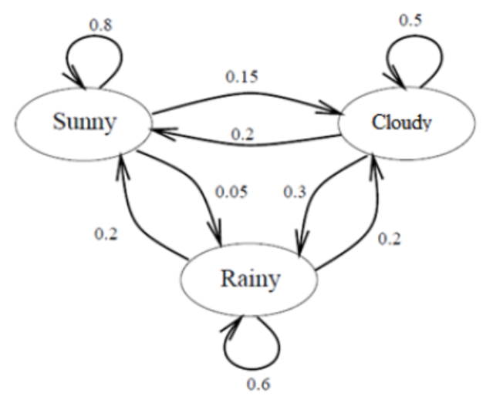
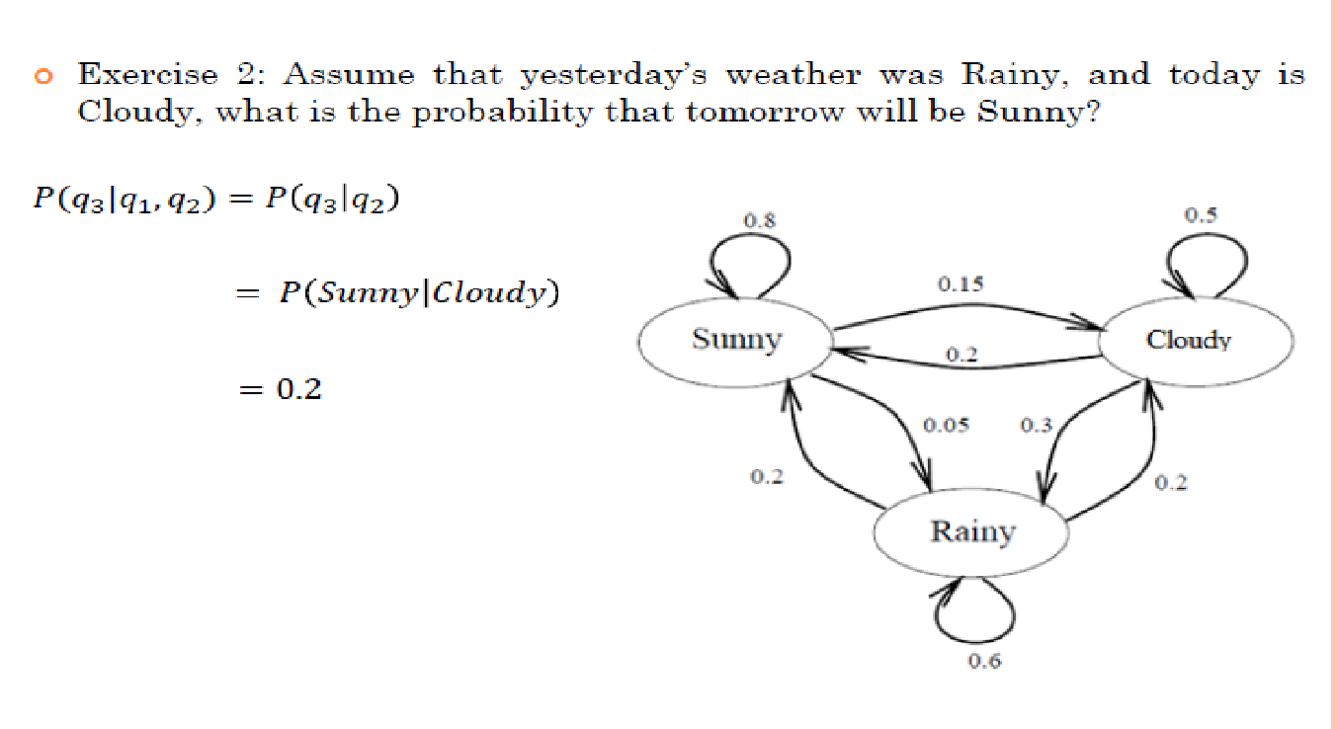
Exercise: Assume that yesterday’s weather was Rainy, and today is Cloudy, what is the probability that tomorrow will be Sunny ?

Slide 10
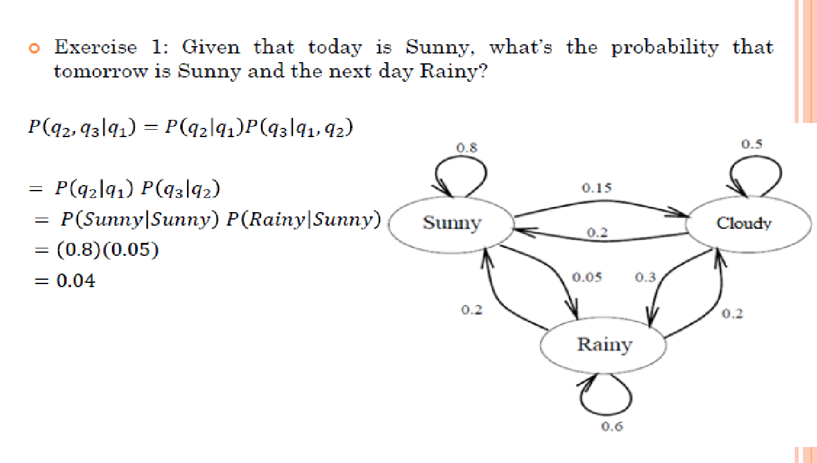
Exercise: Given that today is Sunny, what is the probability that tomorrow is Sunny and the next day is Rainy

Slide 11

Hidden Markov Model (HMM)
A hidden Markov Model is a stochastic model where the states are hidden.
Each state emits an output which is observable.
Suppose, You were locked in a room for several days and you were asked about
the weather outside. The only piece of evidence you have is whether the person
Who comes into the room bringing food is carrying a umbrella or not.
What is hidden ? Weather ( Sunny, Rainy , Cloudy)
What you are observing ? Umbrella or not

Slide 12
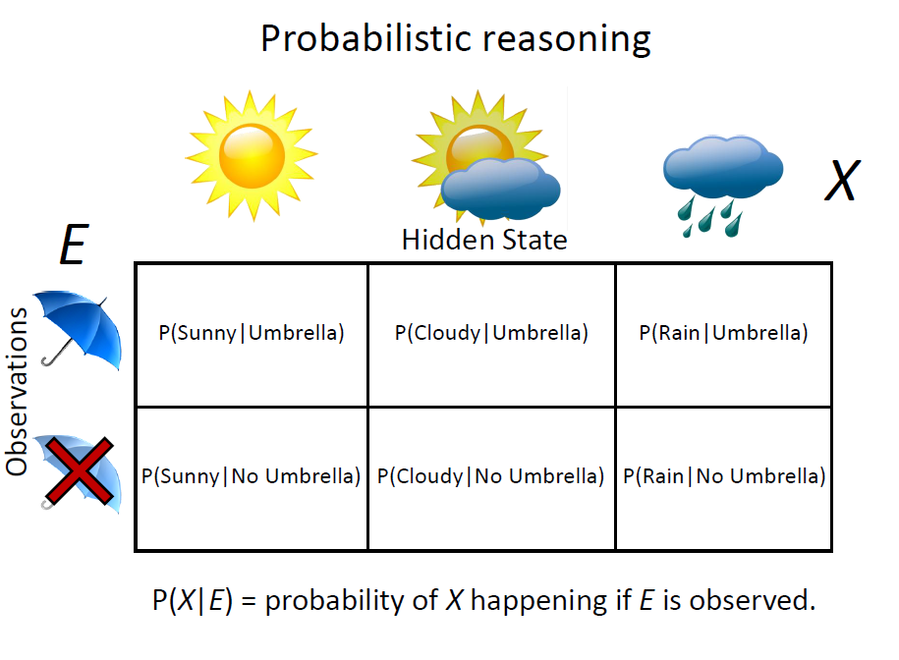

Slide 13
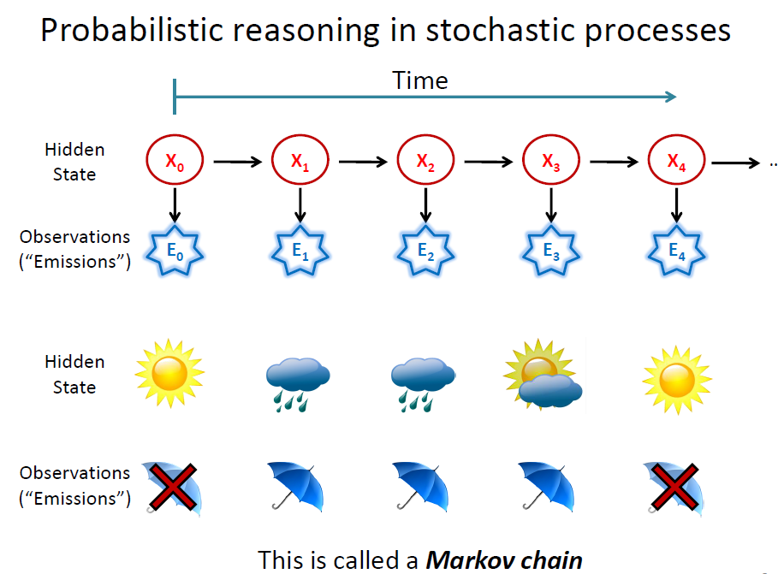

Slide 14
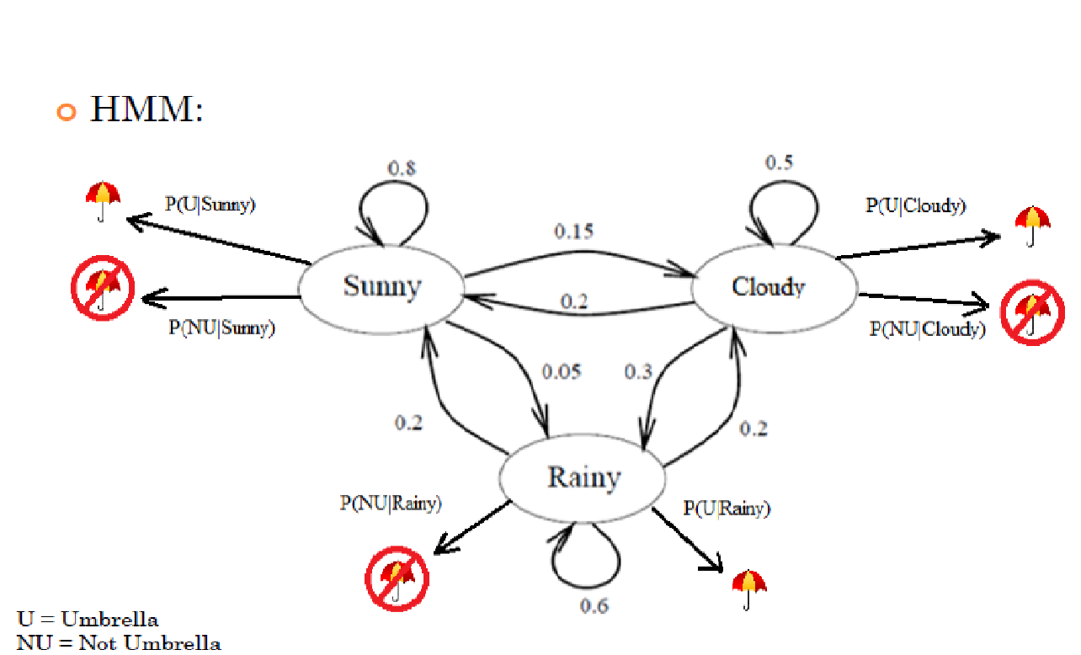
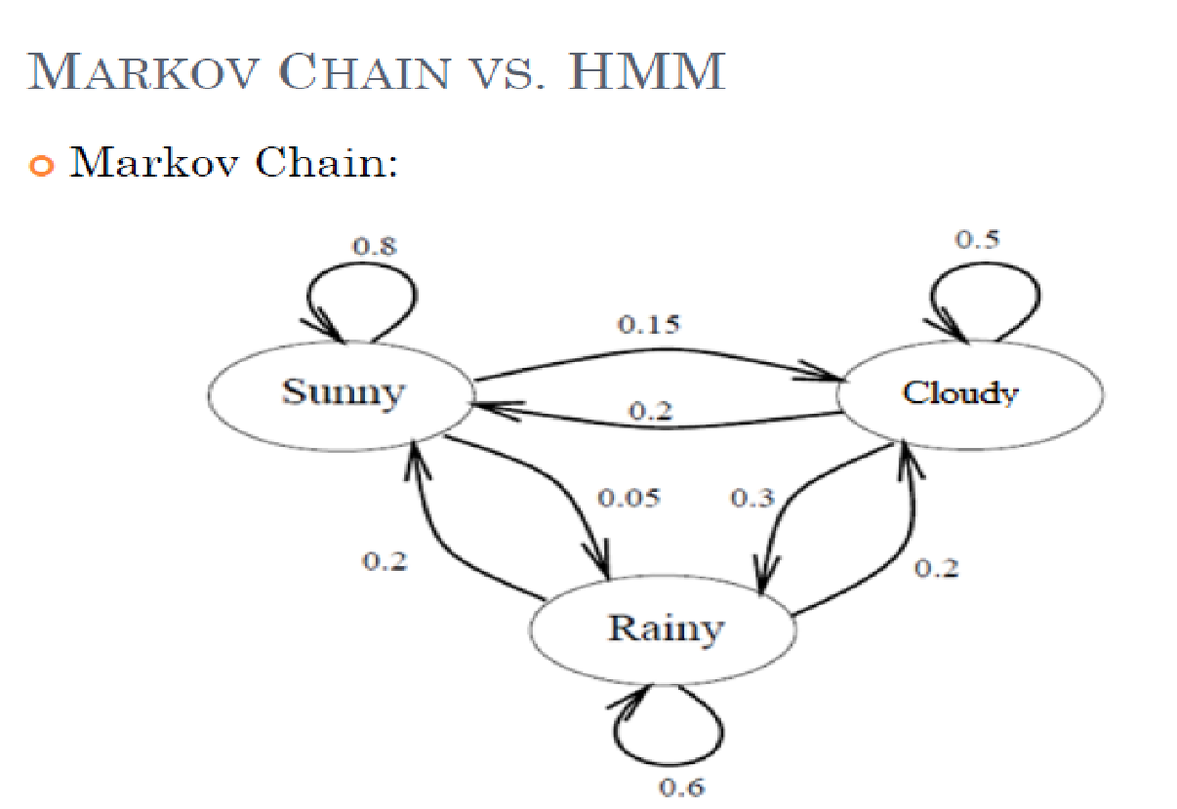
Markov Chain VS (HMM)
A Markov chain is useful when we need to compute a probability for a sequence of observable events.
A hidden Markov model (HMM) talk about both observed events and hidden events which are causal factors in the probabilistic model.

Slide 15
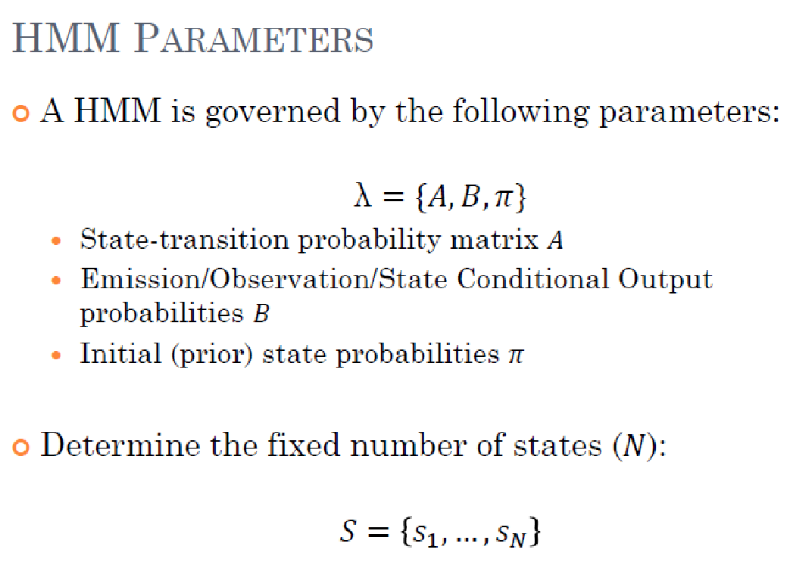

Slide 16
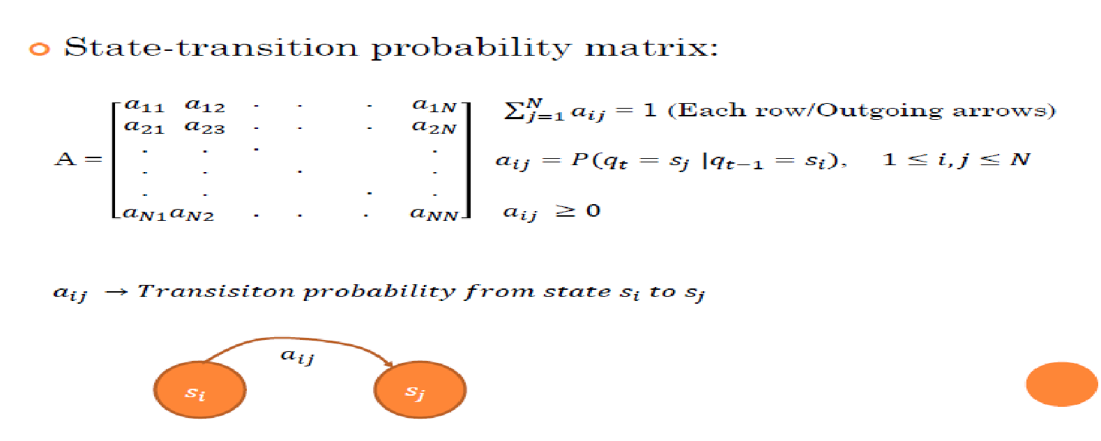
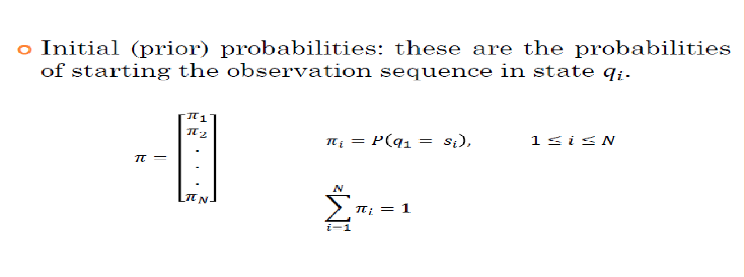


Slide 17
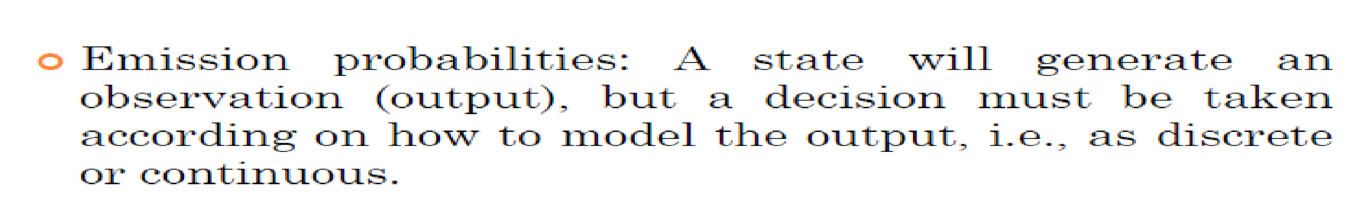
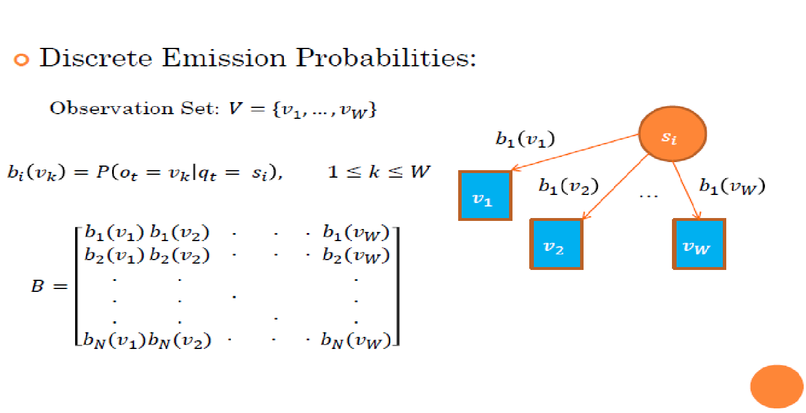

Slide 18
FIRST ORDER HMM
A first-order hidden Markov model instantiates two simplifying assumptions.
• First, as with a first-order Markov chain, the probability of a particular state depends only on the previous state:
Markov Assumption: P(qi | q1...qi-1) = P(qi| qi-1)
Second, the probability of an output observation oi depends only on the state that produced the observation qi and not on any other states or any other observations:
Output Independence: P(oi|q1...qi...qT;o1...oi...oT) = P(oi|qi)

Slide 19
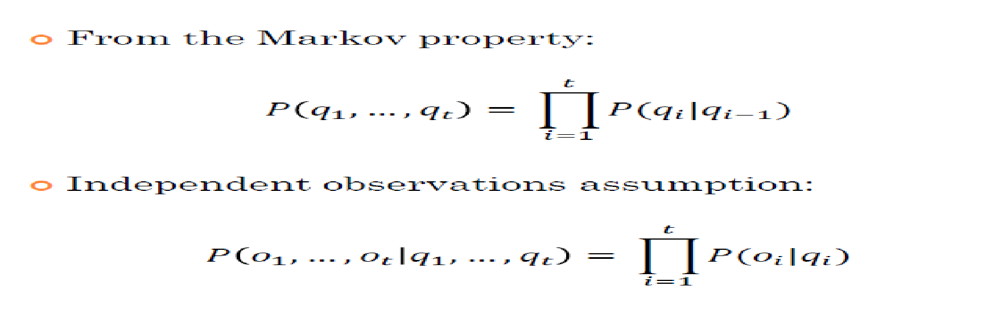
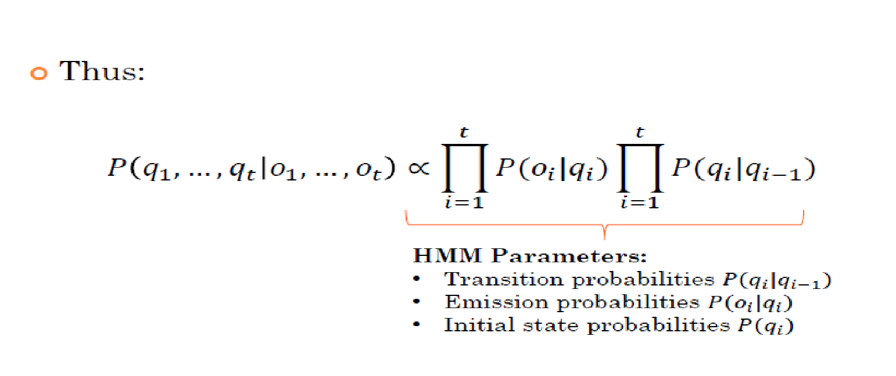

Slide 20
Hidden Markov models should be characterized by three fundamental problems
Problem 1 (Likelihood):
Given an HMM λ = (A,B) and an observation sequence O, determine the likelihood P(O| λ ).
Problem 2 (Decoding):
Given an observation sequence O and an HMM λ = (A,B), discover the best hidden state sequence Q.
Problem 3 (Learning):
Given an observation sequence O and the set of states in the HMM, learn the HMM parameters A and B.
Notes:
Problem 1 (Likelihood):
what is the probability of the ICE CREAM sequence 3 1 3

Slide 21
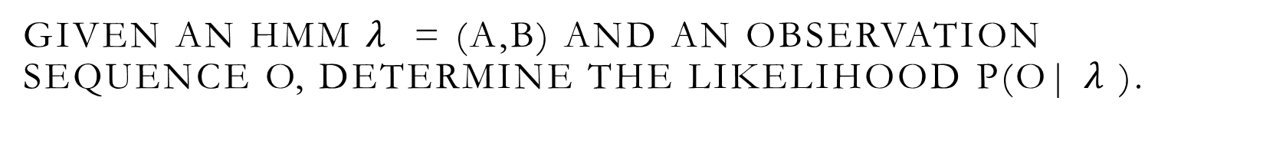
Problem 1 (Likelihood):

Slide 22
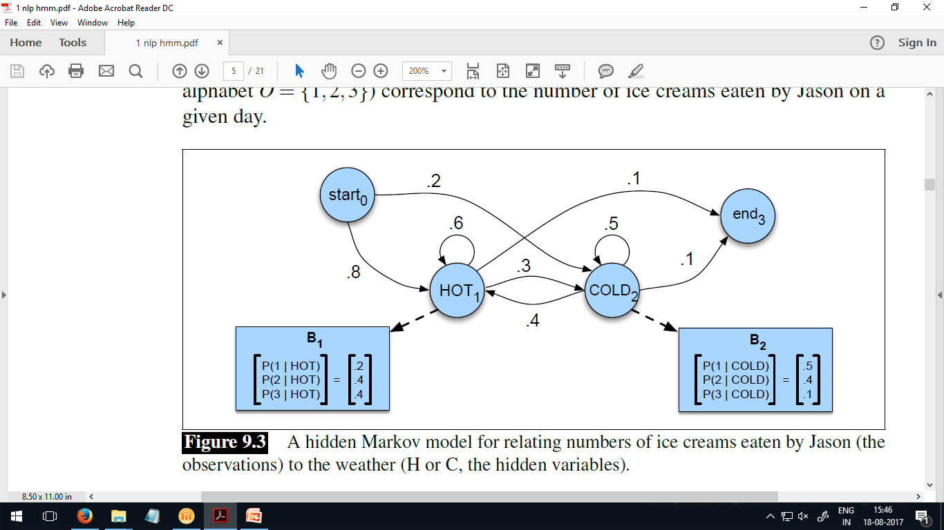
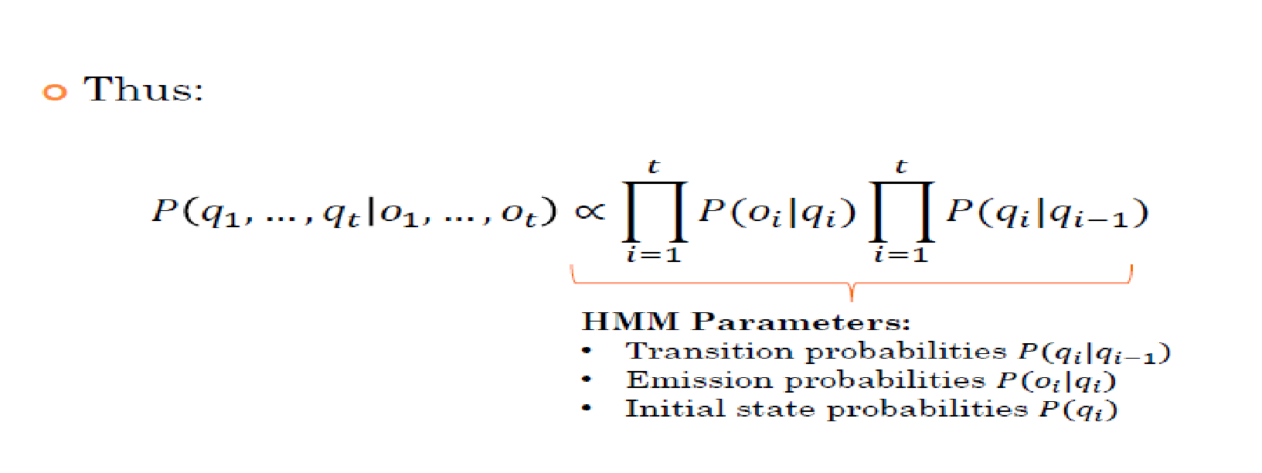
Example
HMM for the ice cream task: The two hidden states (H and C) correspond to hot and cold weather, and the observations (drawn from the alphabet O = {1;2;3}) correspond to the number of ice creams eaten by J on a given day
Source : Chapter 9:Speech and Language Processing. Daniel Jurafsky & James H. Martin.

Slide 23
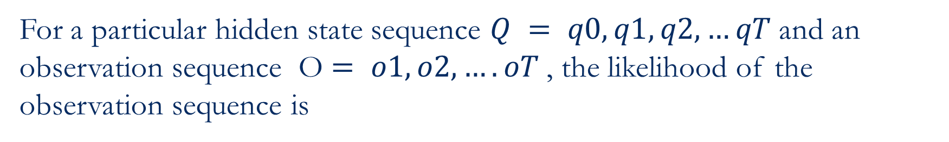
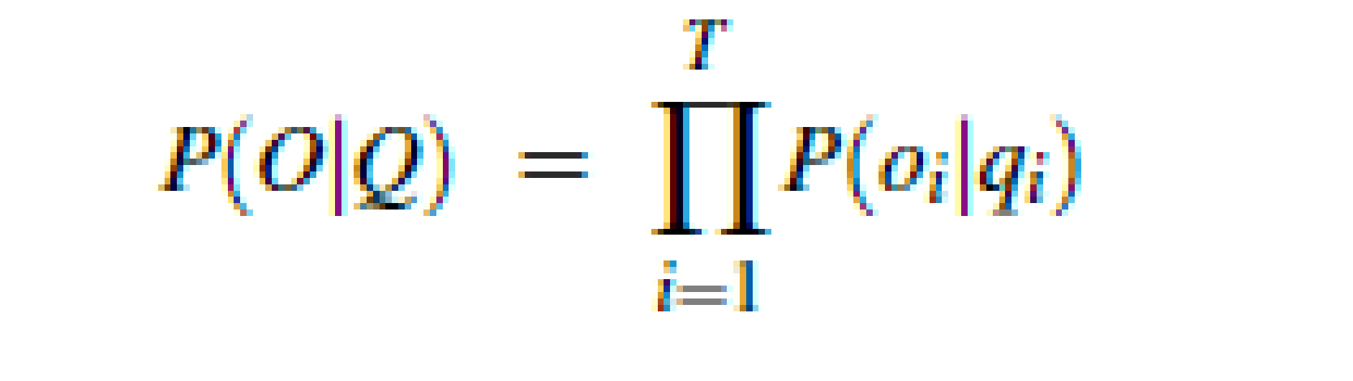
Suppose Observation Sequence O= 3 1 3
Hidden Markov models, each hidden state produces only a single observation. Thus, the sequence of hidden states and the sequence of observations have the same length.

Slide 24
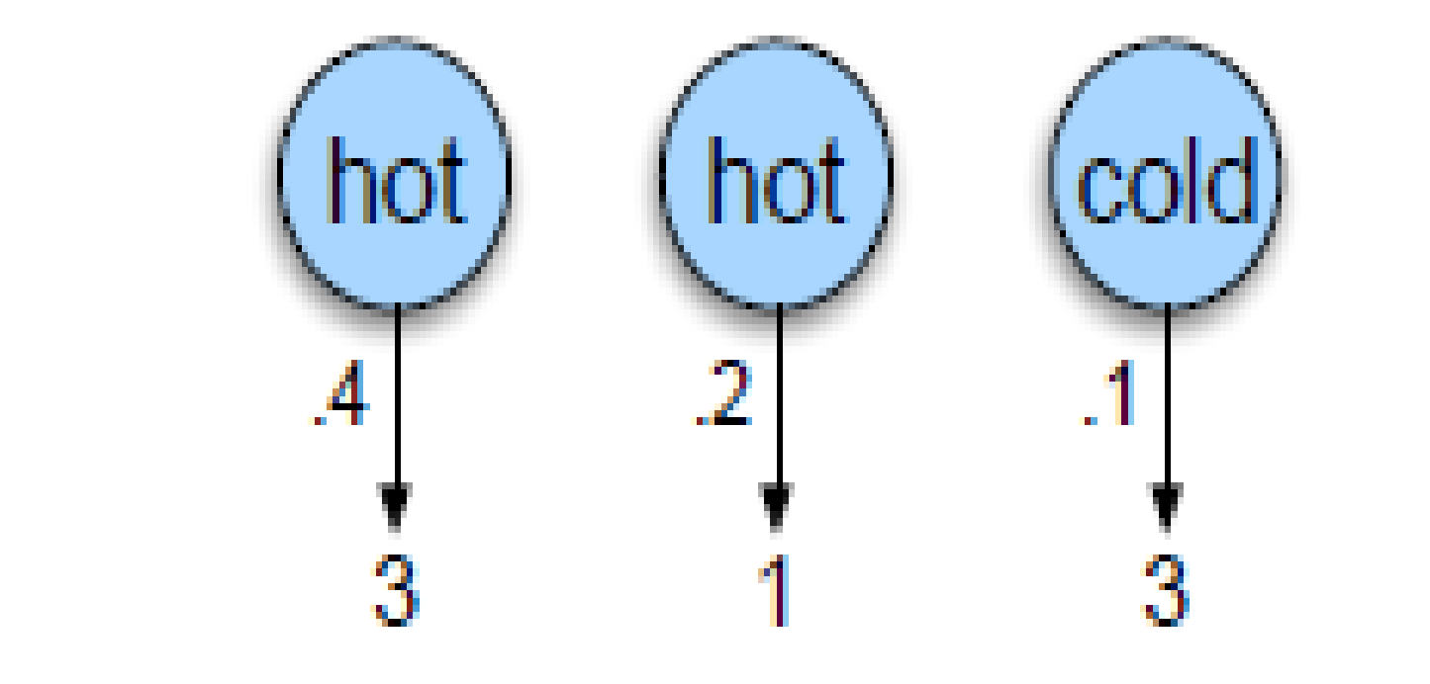
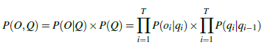
Observation Sequence O= 3 1 3 , One possible hidden sequence is hot, hot, cold
Joint probability of being in a particular weather sequence Q and generating a particular sequence O of ice-cream events is computed as

Slide 25
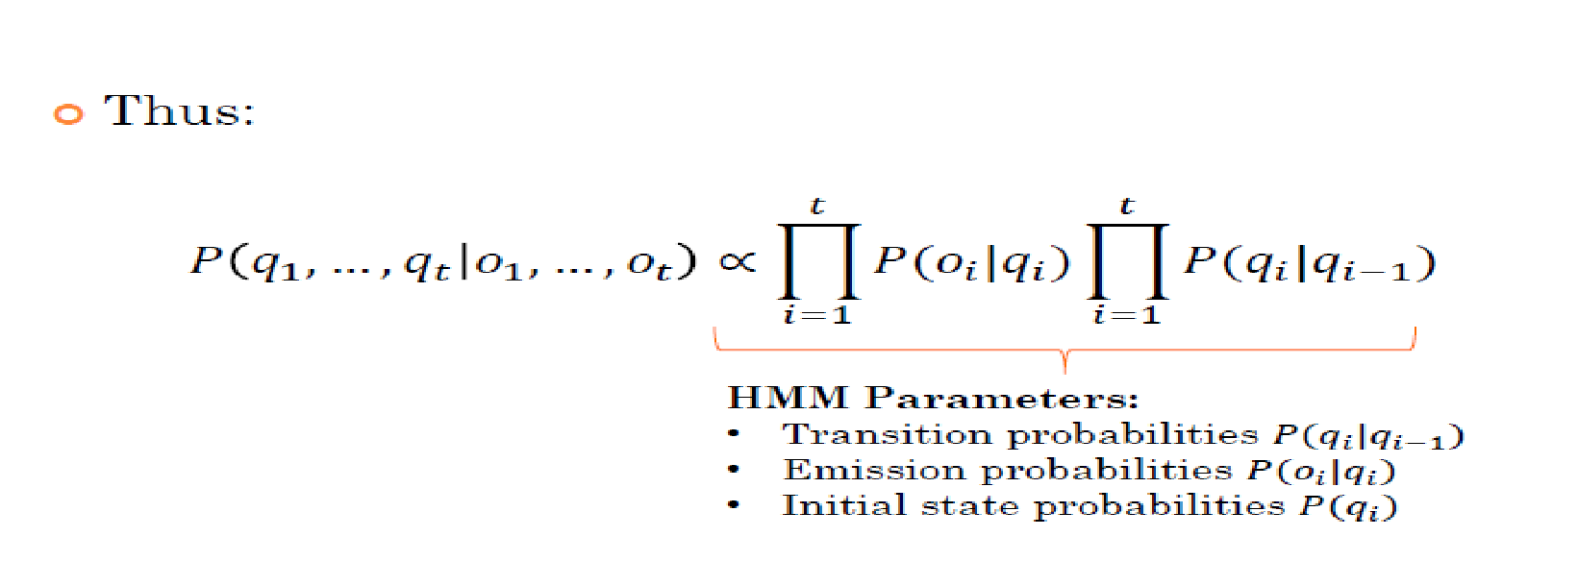
Ex: Problem 1 (Likelihood):
Let s₁ = { hot hot cold}
C = {3 1 3}
P(Q) = P(s₁) = P(hot | start) * P(hot | hot) *P(cold | hot)
P(O|Q) = P(C | s₁) = P(3 1 3 | hot hot cold)
= P(3|hot) * P(1|hot) * P(3|cold)
Now, compute the joint probability of being in a particular weather sequence Q and generating a particular sequence O of ice-cream events
Ie. P(O,Q) = P( C, s_{i}) = P(3 1 3 , hot hot cold)
= P(hot | start) * P(hot | hot) * P(cold|hot) *P(3|hot) *P(1|hot) * P(3|cold)
Finally the P( C) = P( C, s₁) + P( C, s₂)+ ....................... + P( C, s₈)
For this particular case, sum over the eight 3-event sequences cold cold cold, cold cold hot, that is,
P(3 1 3) = P(3 1 3; cold cold cold)+P(3 1 3; cold cold hot)+P(3 1 3; hot hot cold)+ ------
Notes:
Here N =2 (hot and cold)
T=3 (as there elements are generated 3,1,3)
2^3 = 8 is small so this method worked
But when N and T are very large, it creates problem. -> extremely exponential algorithm
Move to forward backward method. -> efficient O(N²T) algorithm

Slide 26
For a sequence of length 3, there can be 2³ = 8 possible sequences of weather (let it be s1.....s8)
Now, find the probability of occurrence of each sequence, s_{i} and then find the probability of occurrence of ice cream sequence C if weather sequence is s_{i}. Then compute the joint probability and add them all.
For an HMM with N hidden states and an observation sequence of T observations, there are N^{T} possible hidden sequences.
For real tasks, where N and T are both large, N^{T} is a very large number, so we cannot compute the total observation likelihood by computing a separate observation likelihood for each hidden state sequence and then summing them.

Slide 27
Likely-hood computation – Forward Algorithm
The forward algorithm is a kind algorithm of dynamic programming algorithm
It uses a table to store intermediate values as it builds up the probability of the observation sequence.
The forward algorithm computes the observation probability by summing over the probabilities of all possible hidden state paths that could generate the observation sequence

Slide 28
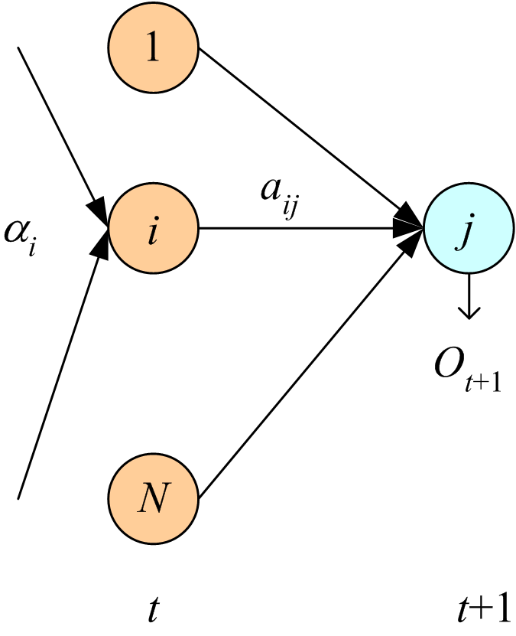
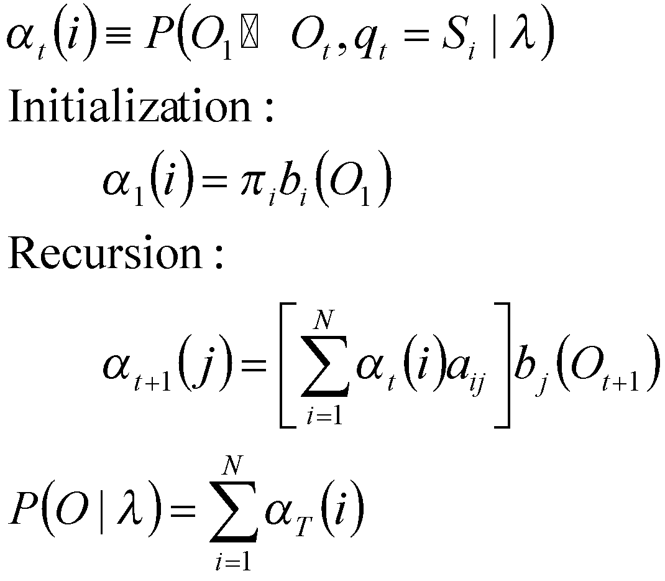
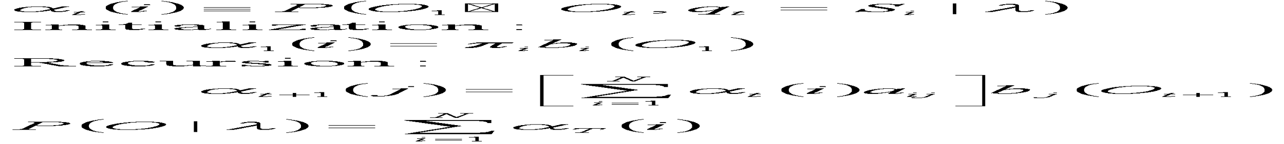
Evaluation : Given λ, and O, calculate P (O | λ)
α_{t}(i) represents the probability of being in state i after seeing the first t observations, given the automaton λ.
Forward variable:
The value α(i) of each cell is computed by summing over the probabilities of every path that
could lead us to this cell.

Slide 29
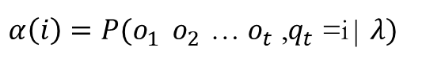
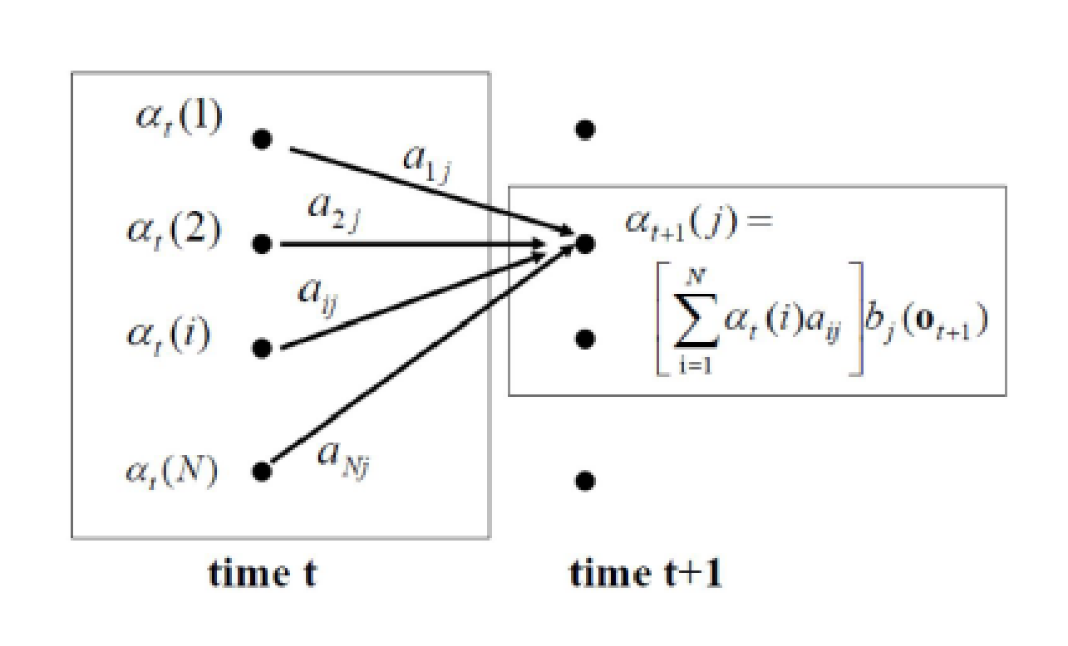
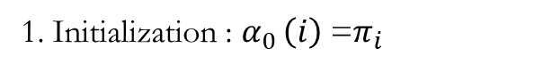
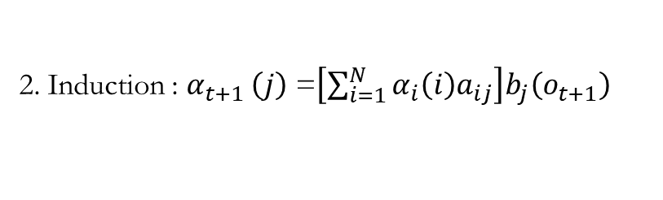
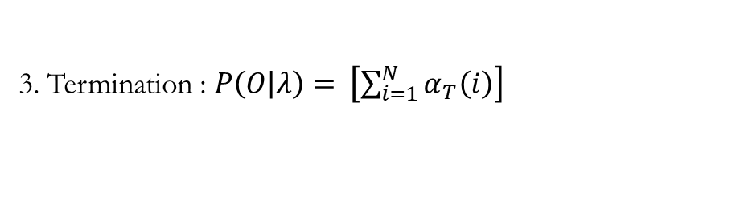
Likely-hood computation – Forward Algorithm
–Our goal is to compute the likelihood of an observation sequence 𝑂=𝑜1,𝑜2,𝑜3… given a particular HMM model 𝜆=𝐴,𝐵,𝜋
Define the probability of seeing observations o₁ to o_{T} , and ending in state i, given HMM 𝜆 :
Source : http://www.cs.tut.fi/~sgn24006/PDF/L08-HMMs.pdf

Slide 30
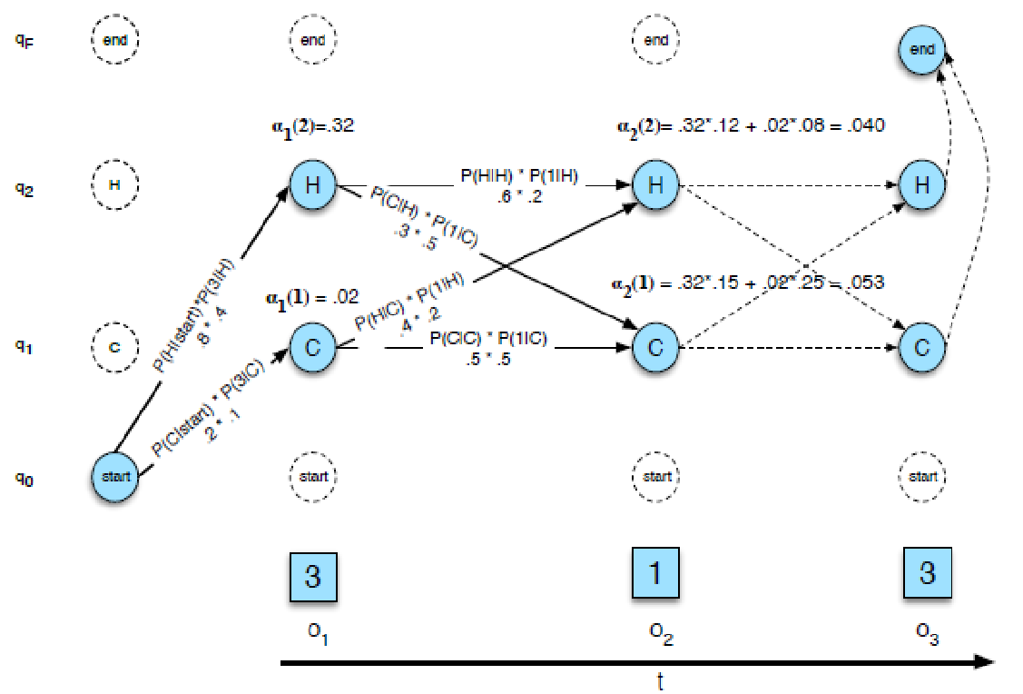
Forward trellis for computing the total observation likelihood for the ice-cream events 3 1 3.

Slide 31
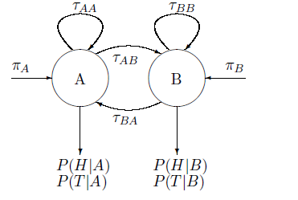
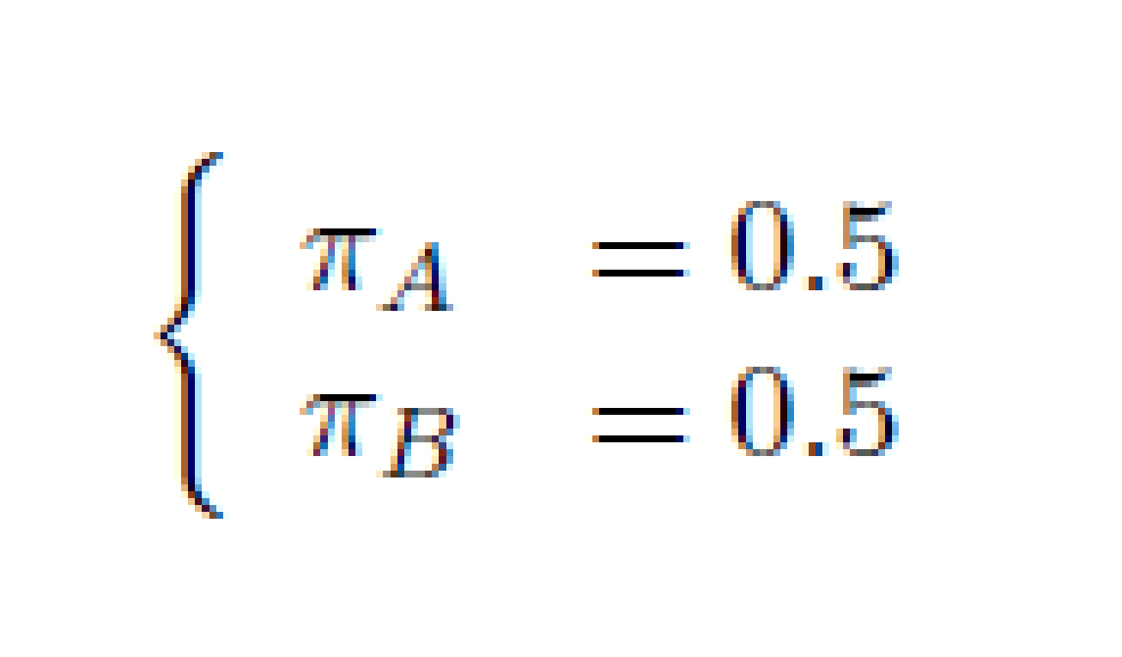
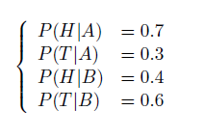
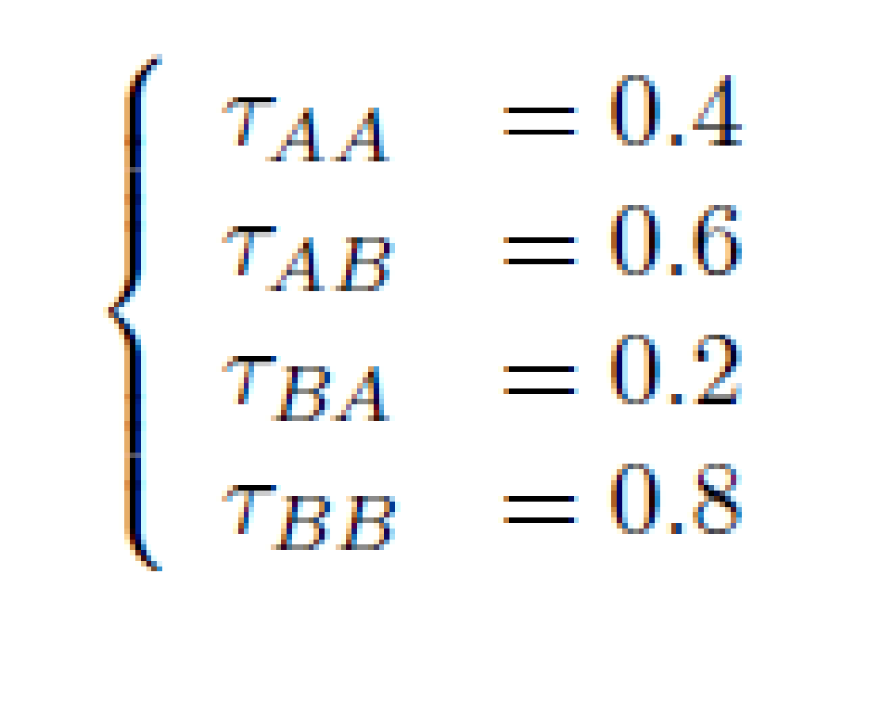
Exercise : Suppose we have two coins (A and B). Coin A has probability 0.7 for coming up heads. Coin B has probability 0.4 for coming up heads. If we use coin A for a given toss, we will retain it for the next toss with probability 0.4. If we use coin B for a given toss, the probability to retain coin B for the next toss is 0.8. The coin initially flipped is equally likely to be coin A or coin B.
a) Formulate the experiment as a Hidden Markov Model. State all parameters of the model.
What is the probability to get "HT" on two successive tosses (H: Head; T: Tail)?
Source : http://brendelgroup.org/WikiVB/data/media/_SCRATCH/cmsORIG/bcb568s10-hw3-solution.pdf

Slide 32
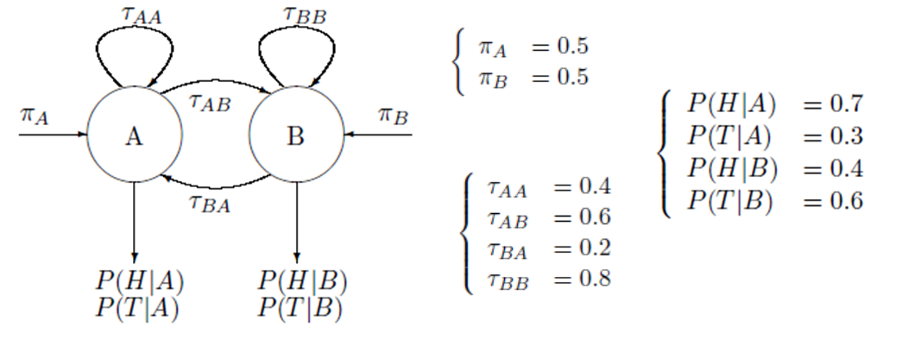
Enumeration of all possibilities
P(HT,AA)= P(H|A)*P(T|A)*P(A)*P(A|A)
P(HT,AB)= P(H|A)*P(T|B)*P(A)*P(B|A)
P(HT, BA)= P(H|B)*P(T|A)*P(B)*P(A|B)
P(HT,BB)= P(H|B)*P(T|B)*P(B)*P(B|B)

Slide 33
b) What is the probability to get "HT" on two successive tosses (H: Head; T: Tail)? Calculate the probability by the HMM "forward" algorithm.
Solution : HMM ”forward” algorithm.
A1 = πA×P(O1 |A) = 0.5×0.7 = 0.35
B1 = πB×P(O1 |B) = 0.5×0.4 = 0.2
A2 = [A1 × τAA + B1 × τBA]×P(O2 |A) = (0.35×0.4+0.2×0.2)×0.3 = 0.054
B2 = [A1 × τAB + B1 × τBB]×P(O2 |B) = (0.35×0.6+0.2×0.8)×0.6 = 0.222
Prob{HT} = A2 + B2 = 0.054 + 0.222 = 0.276

Slide 34
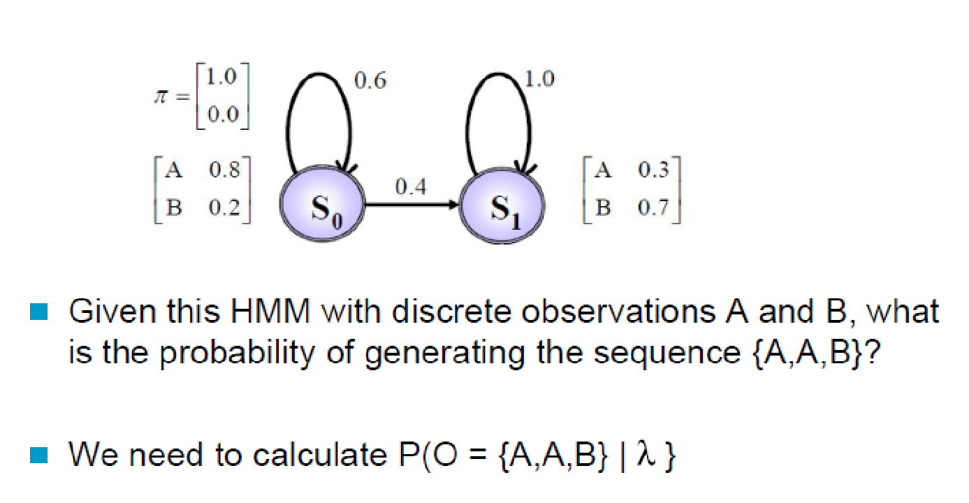
Example

Slide 35
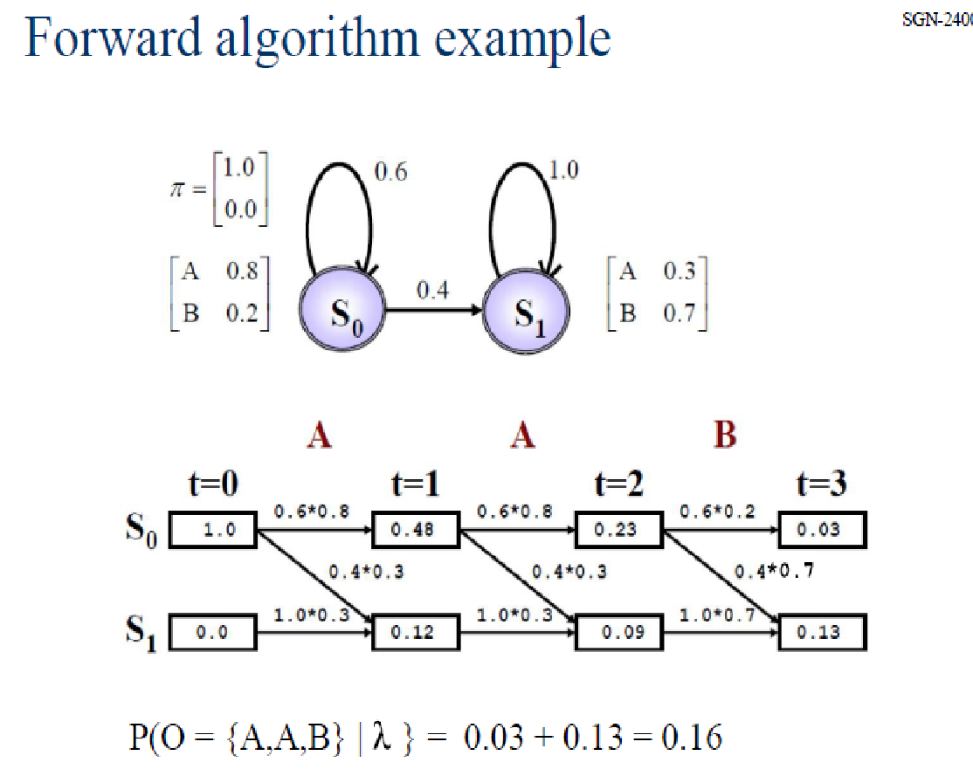
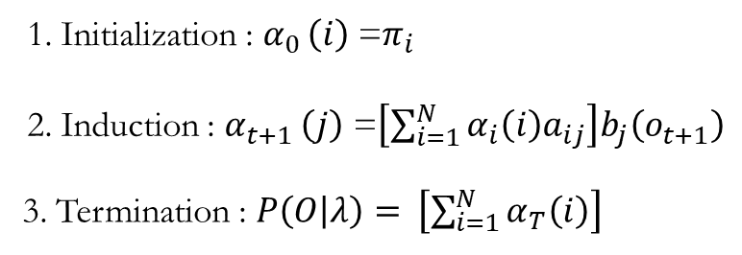

Slide 36
Problem 2: Decoding

Slide 37
Decoding : -The Viterbi Algorithm
For any model, such as an HMM, that contains hidden variables, the task of determining which sequence of variables is the underlying source of some sequence of observations is called the decoding task.
• In the ice-cream domain, given a sequence of ice-cream observations 3 1 3 and an HMM, the task of the decoder is to find the best hidden weather sequence (H H H).
Decoding Task : Given an observation sequence O = { o1, o2, o3, .. oT},and a model , how do we find the best sequence of states q = { q1, q2, q3, .. qT } which maximizes P(O,q| 𝜆 )?

Slide 38
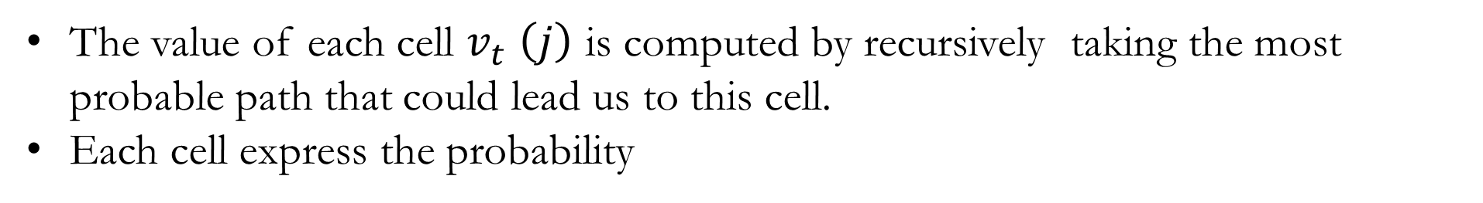
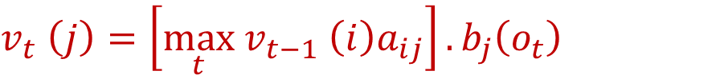
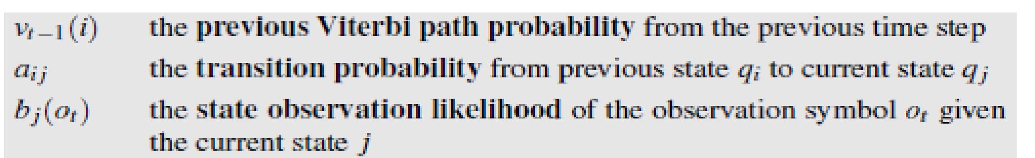

Slide 39
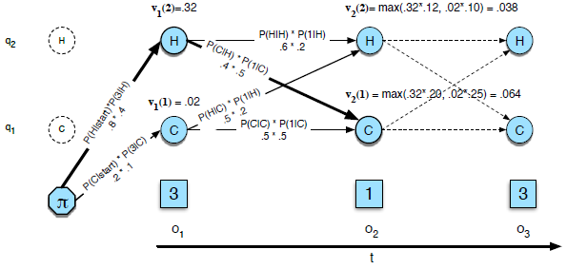
Viterbi trellis for computing the best hidden state sequence for the observation sequence 3 1 3.

Slide 40
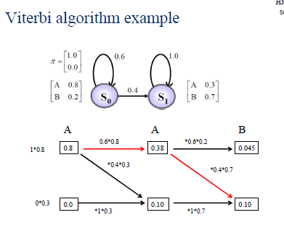

Slide 41
Exercise : Suppose we have two coins (A and B). Coin A has probability 0.7 for coming up heads. Coin B has probability 0.4 for coming up heads. If we use coin A for a given toss, we will retain it for the next toss with probability 0.4. If we use coin B for a given toss, the probability to retain coin B for the next toss is 0.8. The coin initially flipped is equally likely to be coin A or coin B.
a) Formulate the experiment as a Hidden Markov Model. State all parameters of the model.
Source : http://brendelgroup.org/WikiVB/data/media/_SCRATCH/cmsORIG/bcb568s10-hw3-solution.pdf

Slide 42
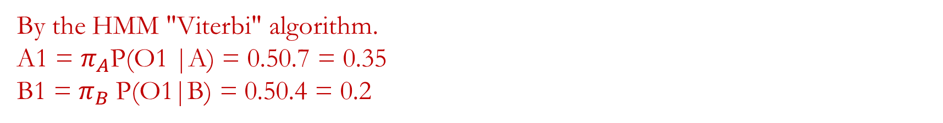
c) If we get "HT", what is the most likely sequence of coins (AA, AB, BA, or BB)? Calculate the probability by the HMM "Viterbi" algorithm.
A2 = max[A1 AA, B1 BA]P(O2 |A) = max(0.350.4, 0.20.2)0.3 = 0.140.3 = 0.042
B2 = max[A1 AB, B1 BB]P(O2 |B) = max(0.350.6, 0.20.8)0.6 = 0.210.6 = 0.126

Slide 43
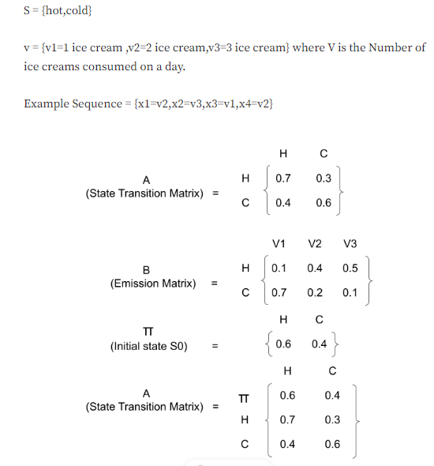
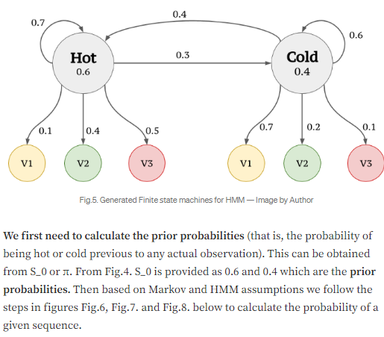

Slide 44




Slide 45


Three important questions in HMM are
What is the probability of an observed sequence?
What is the most likely series of states to generate an observed sequence?
How can we learn the values for the HMMs parameters A and B given some data?
Consider the sequence of emotions : H,H,G,G,G,H for 6 consecutive days. Using the Viterbi algorithm we will find out the more likelihood of the series.

Slide 46


There will be several paths that will lead to sunny for Saturday and many paths that lead to Rainy Saturday. Here we intend to identify the best path up-to Sunny or Rainy Saturday and multiply with the transition emission probability of Happy (since Saturday makes the person feels Happy).
Let's consider A sunny Saturday. The previous day(Friday) can be sunny or rainy. Then we need to know the best path up-to Friday and then multiply with emission probabilities that lead to grumpy feeling. Iteratively we need to figure out the best path at each day ending up in more likelihood of the series of days.

Slide 47


Slide 48
3. Learn the values for the HMMs parameters A and B
Learning in HMMs involves estimating the state transition probabilities A and the output emission probabilities B that make an observed sequence most likely. Expectation-Maximization algorithms are used for this purpose. An algorithm is known as Baum-Welch algorithm, that falls under this category and uses the forward algorithm, is widely used.

